Slide 1
GOOD MORNING!
Today we will:
Turn in BEC Article Summary
Warm Up
Bonding: Ionic or Covalent Investigation
20 min
Notes on Intro to Bonding
HW: DUE Fri 1/29 Bonding: Ionic or Covalent, 1st column of vocab, CARS article

Slide 2
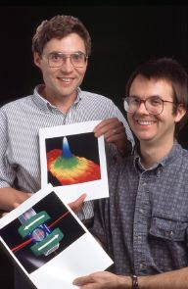
WARM UP: What is BEC?!
Describe what it is
What are the 3 ways in
which it can be achieved?

Slide 3
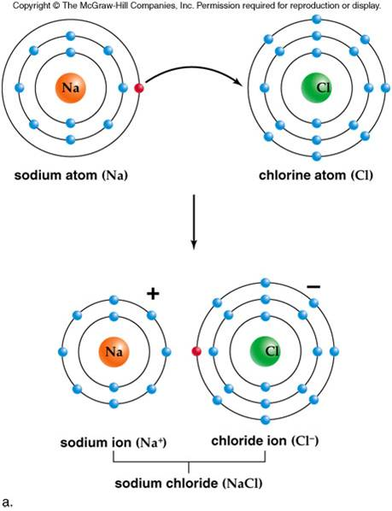
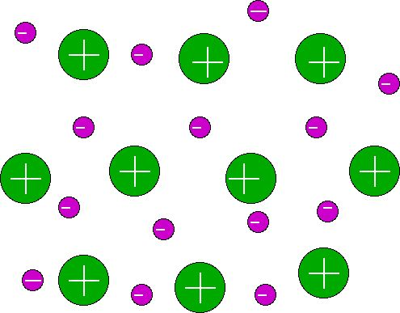
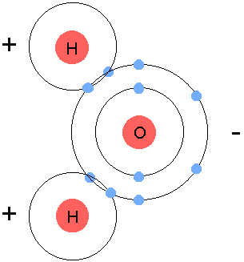
Chemical Bonding
Chemical Bond – force of attraction between 2
atoms due to + and – charges (Coulombic
Attraction)
3 Types of Bonds: Ionic, Covalent, Metallic
+
-
+
-
+

Slide 4
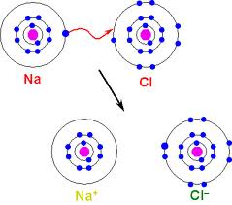
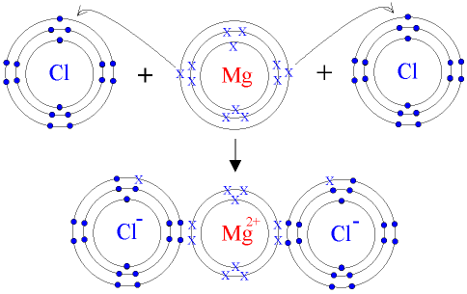
Ionic Bonding
Ionic Bond – attraction between cation (metal) and anion (nonmetal) due to transfer of e⁻(s) from atoms with low IE to atoms with high EN

Slide 5
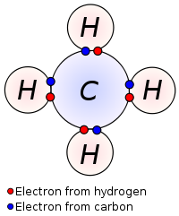
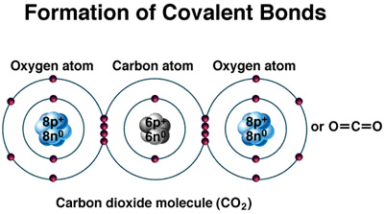
Covalent Bonds
Covalent Bond – attraction between nuclei of bonding atoms and e⁻’s shared between atoms with high EN (nonmetals)

Slide 6
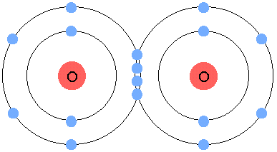
Is it Ionic or Covalent?
Ionic - metal and nonmetal
OR
EN difference > 1.7
Covalent - nonmetal and nonmetal
OR
EN difference < 1.7
I’m ALL covalent!

Slide 7
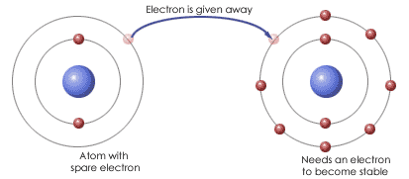
Predicting charge and types of bonds
Determine the charge lithium has as an ion.
Determine the charge fluorine has as an ion.
What type of bond would a compound of lithium and fluorine have? Explain why.
What type of bond would a compound of fluorine and oxygen have? Explain why.
Predict some properties of the 2 compounds above.

Slide 8
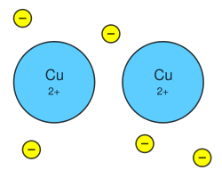
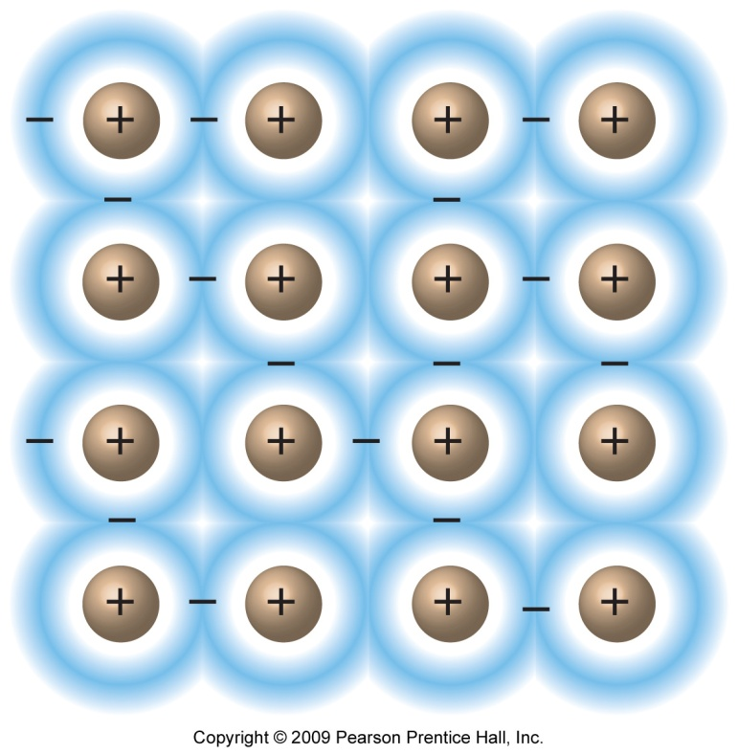
Metallic Bonds
Metallic Bond – attraction between metal cations and free flowing (sea) electrons due to low ionization energies of metals

Slide 9
What type of bond is it?
Determine the type of bond you would expect in the following substances:
CaF₂
C₄H₁₀
PCl₃
FeBr₃
NaC₂H₃O₂
Cu

Slide 10
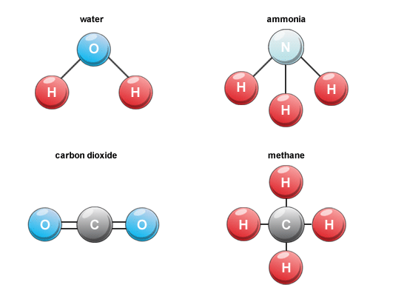
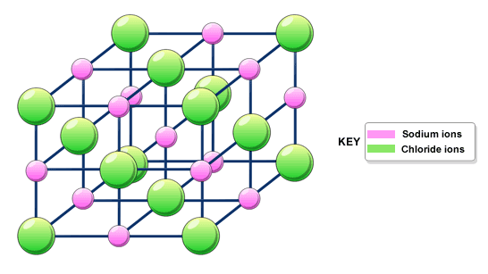
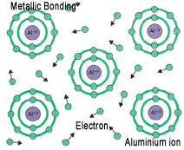
Structures of Different Types of Substances
IONIC COVALENT METALLIC
Lattice of cations and anions
Molecule of nonmetal atoms
Metal cations in sea of electrons

Slide 11
Make the following table in your notes
Criteria | Type of Bonding
 | Ionic | Covalent | Metallic
Type of atoms
Electronegativity
Ionization E.
Role of electrons
Structure
Properties

Slide 12
Types of Substances and their Properties
Ionic Compounds | Covalent Compounds | Metals
High melting pt Usually soluble in water Conducts electricity in water or melt Does not conduct electricity as solid Crystalline | Low melting pt Sometimes soluble in water (polar) Never conducts electricity (except acids) Sometimes crystalline Brittle if solid | Variable melting pt Insoluble in water Conducts electricity Shiny Malleable Ductile

Slide 13
Guidelines for a GREAT data table
Ind Variable(s) on left
Dep Variables across the top (same type of data should fall in columns)
Quantitative and qualitative observations in same table or 2 different tables
Title should include independent and dependent variables
Check EDR

