Slide 1
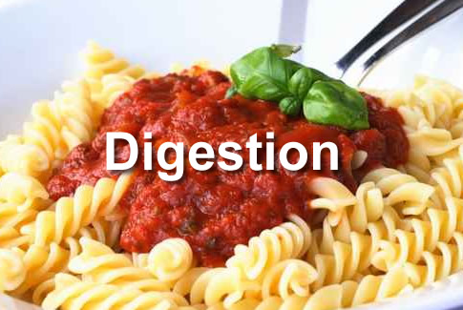
Digestion
Topic 6.1 & Option D.2

Slide 2
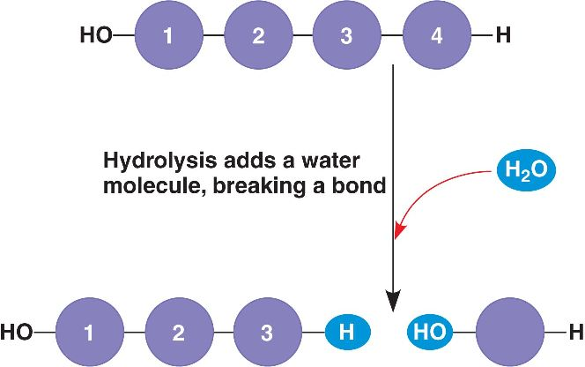
Why digestion?
Food molecules that are ingested (taken in/ eaten) are very large (macromolecules), and they are usually insoluble
Macromolecules must be digested (hydrolyzed/
broken down into smaller and smaller molecules) so
that they are small enough (in simpler form) to be
absorbed – to pass through cell membranes in your
body and into your bloodstream (so you receive
“nutrients” – building blocks for your body/ tissues/
cells)
Additionally, certain foods contain materials not suitable for human tissues (these must be separated and removed)
Large molecule type (macromolecule) | Form of macromolecule ingested | Molecular form after digestion
Protein | Protein | Amino acids
Lipids (fats) | Triglycerides | Glycerol and fatty acids
Carbohydrates | Poly-, di-, and monosaccharides | Monosaccharides
Nucleic acids | DNA and RNA | Nucleotides

Slide 3
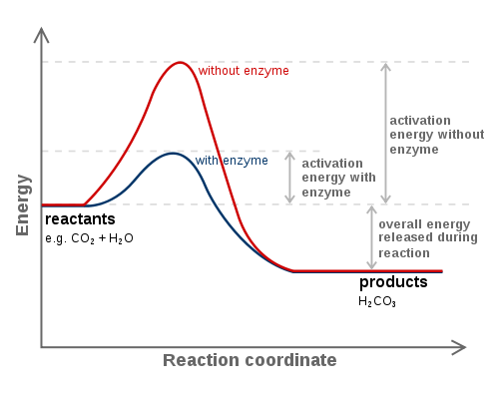
Enzymes and Digestion
Hydrolysis (hydro = water, lysis = breaking) reactions (catabolic reactions) dominate the digestive process
Hydrolysis reactions in the digestive system are catalyzed by digestive enzymes
Enzymes are globular proteins
that lower the activation energy
needed to start a chemical
reaction and speed up the rate
of chemical reactions
Digestive enzymes are released
into the gut from exocrine glands
and they break down larger
molecules
Enzymes allow reactions to occur
more quickly at body temperature (enzymes increase the rate of digestion – at
body temp. these reactions would be too slow on their own). This is ideal
because, by lowering the activation energy of a reaction, the reaction
does not require extremely high temperatures (in humans, high temperatures
cause damage to cells and proteins)
Enzymes break large, insoluble molecules into smaller, soluble molecules that are
easily absorbed into the bloodstream

Slide 4
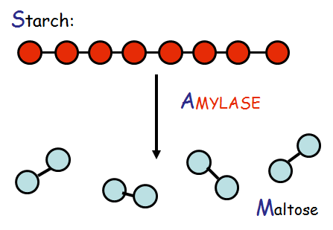
Each digestive enzyme is SPECIFIC for a specific type of food molecule!
Examples:

Slide 5
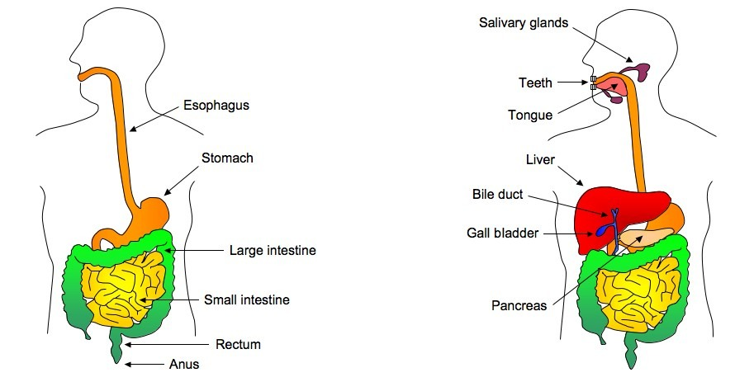
The Human Digestive System
The alimentary canal Accessory digestive organs
long, digestive tube - aid in digestion
food passes THROUGH - food does NOT pass through them

Slide 6
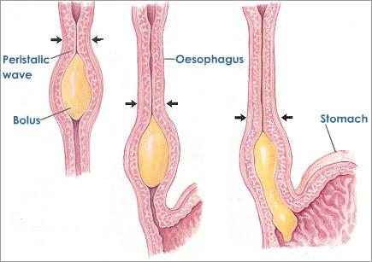
Digestion within the alimentary canal is mechanical and chemical:
Mechanical digestion: Physically breaking large molecules into smaller “chunks” (SAME chemical composition)
chewing, mixing, peristalsis (waves of muscle contraction), and churning of food
Chemical digestion: Hydrolysis (enzymes)
macromolecules hydrolyzed into smaller and smaller molecules (different chemical composition) through enzyme-catalyzed reactions

Slide 7
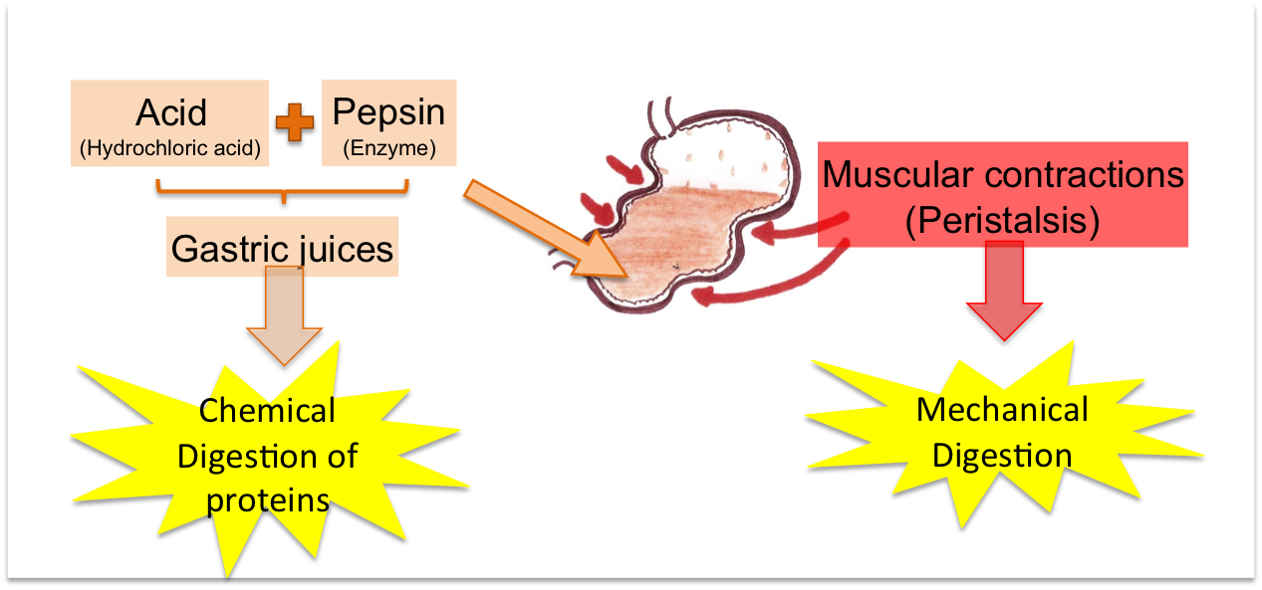
The alimentary canal is divided into three main parts, each with different functions:
1. The Stomach
Begins protein digestion
Pepsin – hydrolyzes peptide
bonds
HCl (hydrochloric acid):
lowers pH to ~2, which denatures proteins
Begins mechanical digestion (physically breaking food into smaller “chunks”)
Muscles contract, mechanically digesting food molecules and mixing/ churning them with enzymes/ gastric juices
Food entering the stomach causes distention (“stretching”) -Stretch receptors (in the muscular walls of the stomach) trigger release of enzymes (which begin chemical digestion: hydrolysis)
Pepsinogen (inactive precursor of pepsin) secreted from chief cells in stomach lining
Gastric pits release HCl, mucous (protective) and other enzymes
Produces chyme (semi-fluid acidic mass of partially digested food that passes into small intestine)

Slide 8
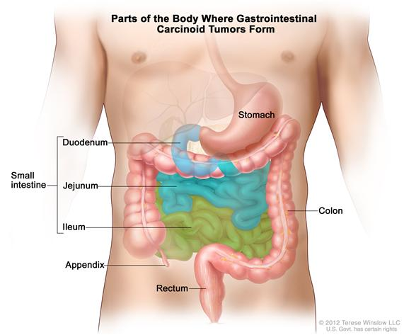
2. The Small Intestine
Completes digestion of food molecules
Chyme enters the
duodenum (1st section)
from the stomach
Bile (from the gall
bladder and liver) is
secreted into the
duodenum to neutralize
acid and emulsify fats
Pancreatic enzymes
(amylase and trypsin) are
secreted to aid in further
starch and protein
hydrolysis
Absorption of water and nutrients (digested food molecules)
Structures called villi (finger-like projections) in the ileum (last section of small intestine) increase surface area and have a rich blood supply
Mixing/ movement of digested food products
Peristalsis (waves of muscular contraction) keeps digested/ undigested food moving through the intestine (from duodenum to jejunum to ileum to large intestine)
Secretes intestinal juice (crypts of Lieberkuhn)

Slide 9
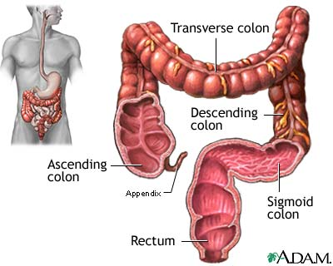
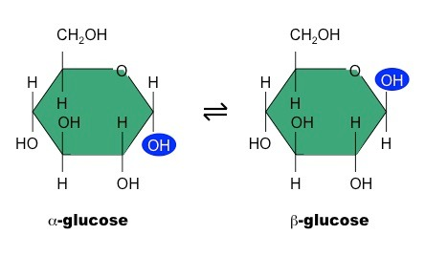
3. The Large Intestine (aka: The Colon)
MAIN FUNCTION: Absorption of water (and minerals/ vitamins)
Highly folded – maximizes surface area for
absorption of water into the blood
Secretes mucous
Lubricates passing faeces
Movement of undigested/
undigestable food products
Peristalsis
Egestion
Elimination of solid waste products
of digestion from the body
Faeces (bile pigments, bacteria, intestinal cells, cellulose, lignin)
Note: Cellulose and lignin are not digested because humans do NOT possess enzymes (cellulase) or gut bacteria to break them down
Glucose exists in two forms: alpha and beta (difference in OH group)
Humans have enzymes/ gut bacteria able to break down alpha form (in glycogen/ starch) but not beta form (celluose –plant cell walls)

Slide 10
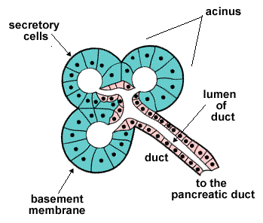
Digestive enzymes are secreted into the alimentary canal by exocrine glands
Exocrine glands have ducts through which their products are secreted. The ducts arise from structures called acini. Each acinus is a single layer of secretory cells (held together by tight junctions), that release their products (in vesicles) into the lumen (space within a tube/ tubular structure) of the exocrine gland duct.
Exocrine glands in the digestive
system: liver, gall bladder,
pancreas, salivary glands,
intestinal glands, gastric glands
Note: Because these types of cells
are secretory, they contain
LOTS of Rough ER (protein
synthesis) and Golgi for
material production and
secretion!

Slide 11
Exocrine Glands and Digestive “Juices”
Several exocrine glands secrete “digestive juices” (fluids containing enzymes) into the alimentary canal.
Salivary glands (salivary amylase)
Gastric glands in stomach wall (pepsin(ogen), HCl)
Pancreas (trypsin(ogen), lipase, amylase)
Glands in the wall of the small intestine (peptidases, carbohydrases)
Digestive juices (saliva, gastric juice, and pancreatic juice) have similarities and differences.
Similarities: ALL contain water, mucous and salts
Differences:

Slide 12
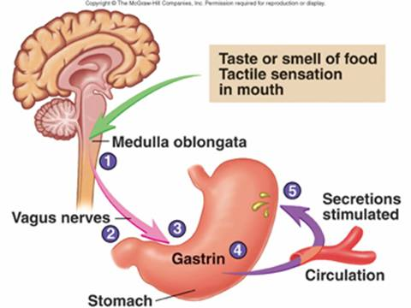
Gastric (Stomach) Juices
Secretion controlled by nerves and hormones:
1. Site/ smell of food triggers
reflex response – gastric
pits in stomach secrete
gastric juices (ensures
gastric juice (pepsin(ogen)
and HCl) presence in stomach
by time food consumed/ when
food arrives)
2. Food enters stomach causing
distention – detected by stretch receptors in stomach lining
3. Impulses from stretch receptors sent to brain (medulla oblongata)
triggering gastrin (hormone) secretion from pits in stomach wall
4. Gastrin causes sustained release of gastric juices (particularly acid
component - HCl)
5. If pH becomes too low, gastrin inhibited by hormones (secretin from
the small intestine/ somatostatin from the hypothalamus)
Note: Hormones are chemicals that are produced by endocrine glands and secreted into the bloodstream (to exert their effects on cells in “other” locations in the body)

Slide 13
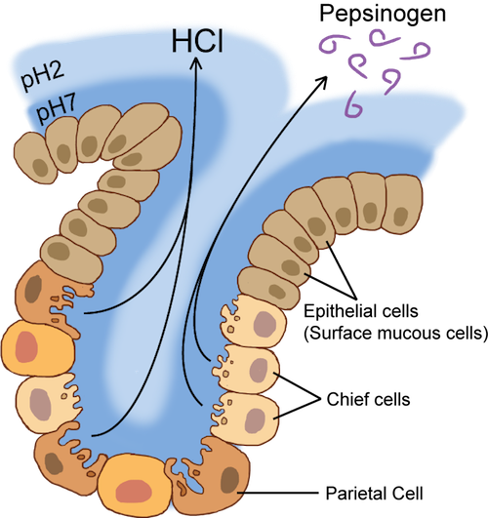
Pepsin and Pepsinogen
Pepsin
a protease – hydrolyzes peptide
bonds in proteins
Initially, it is synthesized and
secreted (by chief cells) into the
stomach in an INACTIVE form (an
“inactive precursor”) called
pepsinogen
WHY?!?
Proteins are an essential component
of ALL cells, so pepsin could essentially
digest the cells secreting it (auto-digestion)
Pepsin is synthesized as an inactive precursor (as pepsinogen) to prevent auto-digestion!
Pepsinogen is activated (into pepsin) in the stomach by HCl
Pepsin does NOT auto-digest stomach cells once it is activated (as a layer of mucous coats/ protects the cells lining the stomach wall)

Slide 14
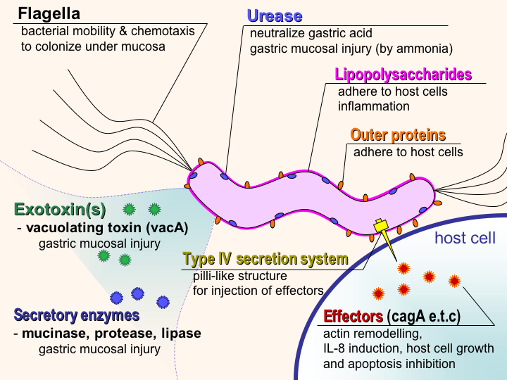
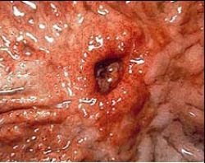
Gastric Juices, H. pylori and Ulcers
Stomach ulcers = inflamed/ damaged areas of/ open sores in the stomach wall
Recently (~1980’s), scientists noticed there is a strong correlation between Helicobacter pylori (a bacteria) infection and the development of stomach ulcers.
WHY? HOW?
H. pylori survives the
acidic conditions of
stomach mucosa:
Secretes urease to increase
pH and to neutralize gastric
acids to allow colonization (of
stomach mucosa)
2. Secretes mucinase to
degrade the mucous lining of
stomach wall to “burrow in” –
allowing for damage (ulcers) in these areas of the stomach wall by gastric juices
Prolonged damage to stomach wall (and chronic H. pylori infection = 20+ years) may lead to stomach cancers
Previously, ulcers and stomach cancers were thought to be caused by stress/ diet

