Slide 1
GOOD MORNING!
Today we will:
Put Binders on Lab Table #7 for Binder Check
Take Unit 4 Test
Alternative Sources of Energy
Lab Groups: put together Power Point presentation for MON
Notes
HW: Carbon Bathtub Article Summary DUE Mon 11/16 & Alternative Sources of Energy Presentation

Slide 2
Renewable Sources of Energy
Lab Group #1: Biofuels – Plants
Lab Group #2: Biofuels – Animals
Lab Group #3: Wind
Lab Group #4: Solar
Lab Group #5: Hydro Electric
Lab Group #6: Tidal
Lab Group #7: Geothermal
Lab Group #8: Nuclear

Slide 3
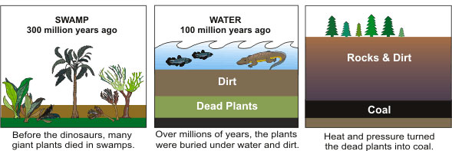
Fossil Fuels are “Non-renewable” carbon fuels
Fossil fuels form when dead plants and animals are buried under sediments, and sometimes oceans, for millions of years
Pressure and heat convert the organic molecules into molecules composed of mostly carbon and hydrogen
These carbon and hydrogen molecules can form solids (coal), liquids (oil), or gases (natural gas)

Slide 4
GOOD MORNING!
Today we will:
Turn in Carbon Bathtub Article Summary
Meet with Lab Group for Presentation
10 minutes
Share Slide presentation with Ms. Chen mchen@lps.k12.co.us
Notes on Alternative Energy Sources
Begin Work & Power Notes/Practice Problems
HW: Unit 5 Vocab DUE Wed 11/18

Slide 5
Energy resources on Earth
Most of the energy on Earth comes
from the sun
Fossil fuels: light energy converted to chemical energy by plants
Wind: wind is caused by uneven heating of the Earth’s atmosphere
Waves: waves are caused by wind
Solar: the sun of course!
Biofuels: light energy converted to chemical energy by plants

Slide 6
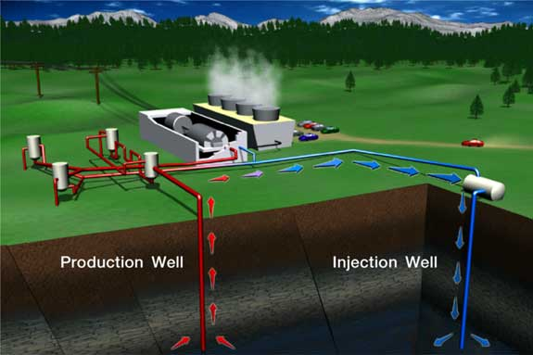
Some types of Energy are not from the Sun
Nuclear: Nuclear energy in radioactive isotopes
Hydroelectric: Kinetic Energy in water moving due to gravity
Geothermal: heat from the Earth’s core
Hydrogen fuel cells: chemical energy in hydrogen molecules

Slide 7
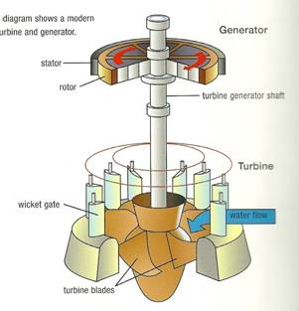
Turbines
A turbine is a machine that converts kinetic energy into useful work, usually electricity
Turbines depend on
moving particles such
as water, steam, or air.
http://www1.eere.energy.gov/wind/wind_animation.html
Electricity (e⁻ flow)

Slide 8
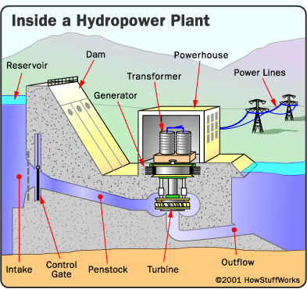
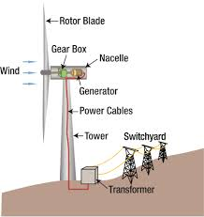
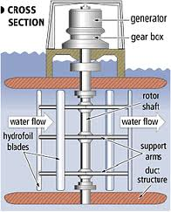
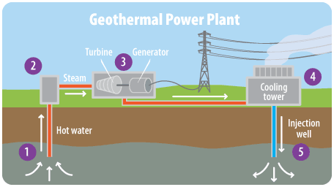
Types of Turbines Used For Alternative Energy
Wind
Hydroelectric
Wave
Geothermal

Slide 9
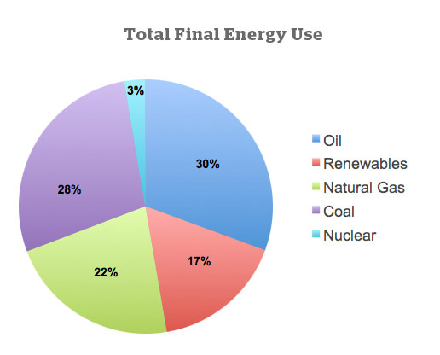
The Energy We Use
Fossil fuels provide most of the energy humans currently use.
Fossil fuels include COAL, OIL, AND NATURAL GAS
A look at world energy consumption by fuel type in 2010. Source: Energy Transitions by Cutler Cleveland

Slide 10
Resources for Researching Alternative Energies
http://www.energyquest.ca.gov/story/chapter12.html
http://www.eia.gov/kids/energy.cfm?page=2
http://www.our-energy.com/
http://www.nrel.gov/
http://energy.gov/science-innovation/energy-sources/renewable-energy
http://www.darvill.clara.net/altenerg/index.htm

