Slide 1
GOOD MORNING!
Today we will:
Can Demo
Quiz ☺
Refresh Ideal Gas Law
Go over calculations from the lab
Esp. #6-9
Complete Dalt Avo Ideal Gas Law Problems
#1-9 at the end of class get signature from Ms.Chen
Ideal Gas Law + Stoichiometry
HW: DUE Tues 1/19 Rough Draft of typed conclusion to Lab

Slide 2
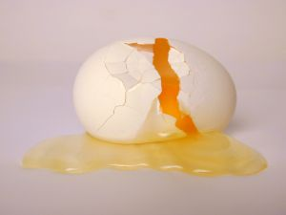
Whew! That Stinks!
Hydrogen sulfide, H₂S, is
produced when eggs get rotten.
When 0.50 moles of H₂S is produced at 24°C and 632 mmHg the volume is 14.7 L. What is the volume at STP?
What is the volume if 1.0 mole of H₂S is produced at STP?
Determine the mass of H₂S produced when the volume is 2.98 L at 24.5°C and 93.6 kPa.

Slide 3
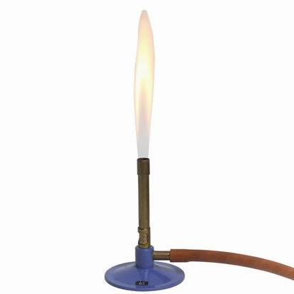
Using Stoichiometry to determine moles or volume of a gas
The coefficients in a balanced equation provide a mole ratio between reactants and products.
The standard (STP) molar volume of a gas is 22.4 L
Work following problem:
CH₄ + 2 O₂ → CO₂ + 2 H₂O
Determine the volume of CO₂ produced when 25.0 g of methane (CH₄) is burned at STP.
What is the volume of CO₂ at 92 kPa and 21˚C?

Slide 4
GOOD MORNING!
Today we will:
Turn in #10-15 of Ideal/Stoich problems
Hold onto Molar Volume of a Gas Lab
Warm Up
Ideal Gas Law + Stoich
Peer Edit Conclusion to Gas Lab
Hand back Gas Quiz
Revisions DUE at the end of class
Work on Review Packet
HW: DUE Final Draft of Conclusion to Molar Volume of a Gas Lab

Slide 5
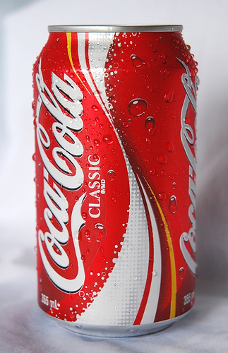
There are 205 mL of gas in an aluminum can at 85°C and 0.832 atm.
Determine the volume of
the gas when the can is
cooled to 3°C and the pressure is 1 atm.
Explain what happens to the gas in the
can (on a molecular level).

Slide 6
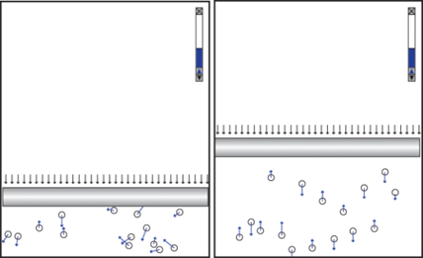
P, V, T, n Calculations
Determine the volume of 50.0 g of NO₂ gas at room temperature (25.0°C) and 625 mmHg.
2 NO₂ → N₂ + 2 O₂
Determine the volume of N₂ gas at STP when 15.0 g of
NO₂ decomposes.
A gas is in a cylinder with a movable piston. Explain
how pushing the piston down changes the volume and
pressure of the gas.
Sketch a graph showing the
relationship between volume
and pressure.

Slide 7
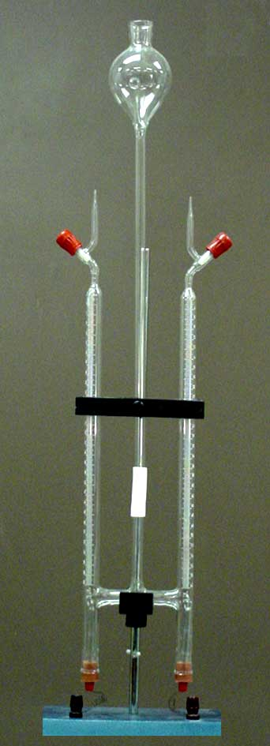
Electrolysis of H₂O
Hydrogen gas is collected over water
The barometric pressure is 625 mmHg and
the room temp is 25˚C. The vapor pressure of
water is 18 mmHg.
What is the pressure of the hydrogen gas?
If the volume of hydrogen gas is 38.9 ml, how
many molecules of hydrogen are collected?

Slide 8
Peer Edit Conclusion
CONCLUSION
Restate purpose (NOT problem statement) of the lab
Identify relationship between variables (length of Mg used and volume of H₂ produced) Include numbers.
State the results of your experiment. Include numbers.
Use scientific laws, theories, and/ or principles (such as Avogadro’s Law) to explain how the standard molar volume of a gas could be determined from the volume of H₂ produced at room temperature and pressure. Include parenthetic reference(s).
Compare results with published/ accepted values.

Slide 9
Keep Editing
EVALUATION OF EXPERIMENT
Suggest a logical source of error.
Explain the effect of the error on the experimental results (standard molar volume) and INCLUDE numbers.
State the validity of the experimental results based on your percent error.
IMPROVING THE EXPERIMENT
Suggest at least 1 improvement based on the identified error.
Suggest a different way to investigate molar volume.
REFERENCE
Cite source(s) in complete APA format

Slide 10
Gas Demos: How, What, Why?
Explain one of the gas/phase change demos that you observed in class:
Boiling water in flask
Egg in and out of flask
Can heated and cooled
Include: “How” it was done (the equipment, materials),
“What” happened, and “Why” it happened using changes in pressure, volume, and temperature on a molecular level

