Slide 1
GOOD MORNING!
Today we will:
Turn in Phases of Matter & Gas Law Practice Problems
KEY posted on website
Warm Up
Hard Boiled Egg Demo
Put Gas Laws into Notes
Dalton, Avogadro, & Ideal Gas Law Problems
QUIZ – Friday
HW: DUE Wed 1/13 Molar Volume of a Gas: Problem Statement/Pre Lab Questions DUE Fri Dalt Avo & Ideal Gas Problems

Slide 2
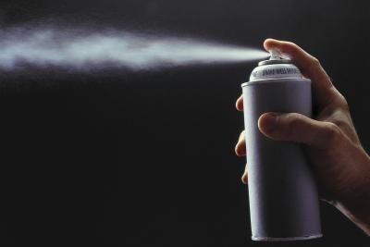
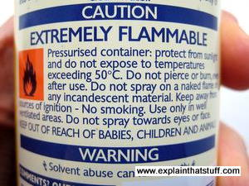
WARM UP
What would happen to the pressure of a gas if we increased the temperature?
The gas in a used aerosol can is at a pressure of 103kPa at 25°C If the can is thrown into a fire, what will the pressure be when the temperature reaches 928°C

Slide 3
Kinetic Molecular Theory of Gases
Particle Size
2. Particle Motion
3. Particle Collisions

Slide 4
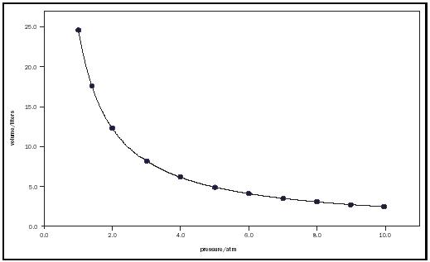
Boyle’s Law
Statement
Relationship P₁V₁ = P₂V₂

Slide 5
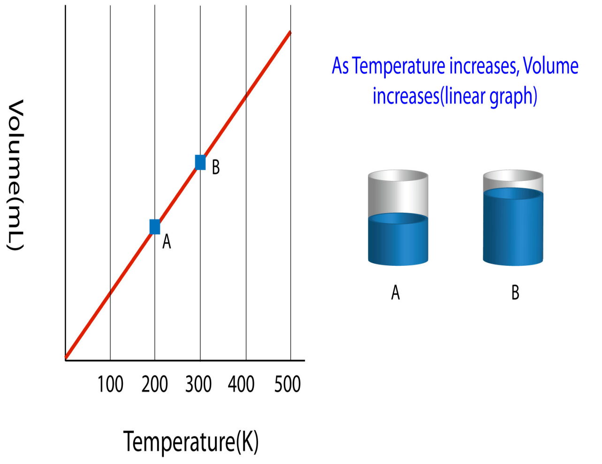
Charles’ Law
Statement
Relationship V₁ = V₂ T₁ T₂

Slide 6
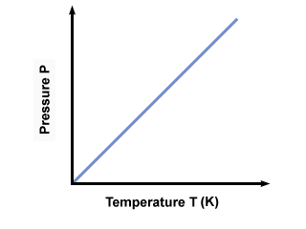
Gay-Lussac’s Law
Statement
Relationship P₁ = P₂ T₁ T₂

Slide 7
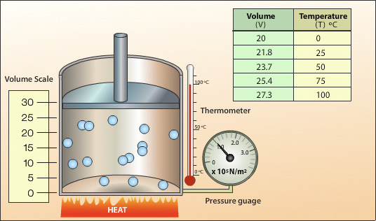
Combined Gas Law
https://phet.colorado.edu/en/simulation/gas-properties
Equation:
P₁V₁ = P₂V₂ T₁ T₂
STP = standard
temp and pressure,
273 K and 1 atm
at STP
1 mole of gas occupies 22.4L

Slide 8
Gases are CRAZY!
An expandable container has a sample of 1.0
mole of neon gas (Ne) at 627.2 mmHg and
22.5°C. If the initial volume is
29.4 L, what will the
volume be at STP?

Slide 9
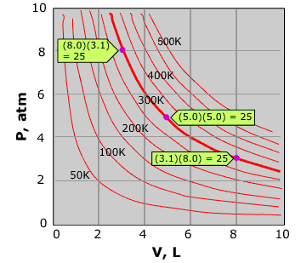
Pressure, Volume Relationship
The pressure and volume of a gas is measured and graphed at several temperatures.
Explain why the volume of a gas increases when the pressure decreases.
Which temperature shows the largest decrease in pressure for a 1.0 liter increase in volume? Provide evidence.
If the volume of a gas is 125 mL at 632 mmHg, what will the volume be when the pressure is increased to 784 mmHg?

Slide 10
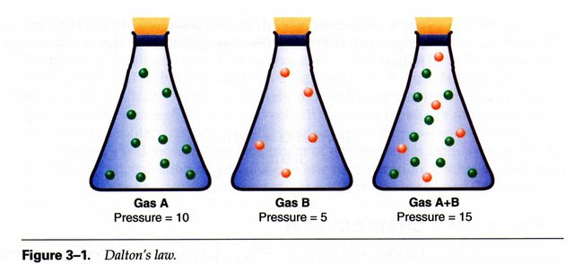
Dalton’s Law of Partial Pressures
Equation
P_{T} = P_{a} + P_{b} + P_{c} + ….

Slide 11
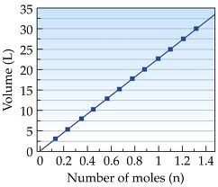
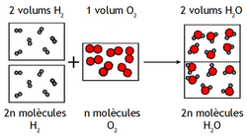
Avogadro’s Law
Equal volumes of gas at the
same T and P have equal
number of particles or moles.
V_{a} = n_{a}
V_{b} = n_{b}

Slide 12
Ideal Gas Law: PV = nRT
Ideal Gas Constant: R = 0.0821 atm L
mol K
R = 8.31 kPa L mol K
Solve for:
Moles
Volume
Pressure
Temperature

Slide 13
What really happens to a gas when it is cooled?
A helium balloon has a volume of
4.72 L at 0.865 atm and 298 K.
What is the volume when it is cooled to
255 K with the same pressure?
Describe what happens to the particles of He as it is cooled.
Sketch a graph showing the relationship between volume and temperature and indicate the change in the balloon on the graph.

Slide 14
Use the Ideal Gas Law
Determine the volume of 2.5 mole of gas at STP
If the gas used was He, how many grams of He would you need for this volume of gas?

Slide 15
GOOD MORNING!
Today we will:
Warm Up
Molar Volume of a Gas Lab
QUIZ – Friday
HW: DUE Fri 1/15 Calculations to Gas Lab & Study for Quiz
– Edit to HW Dalt Avo Ideal Gas Law Problems (due at end of class Friday!)

Slide 16
Quiz
Phases, phase changes, kinetic energy
Phase diagrams and Graphs
Boyle’s, Charles’, Gay-Lussac’s Gas Laws or (Combined Gas Law), Ideal Gas Law

Slide 17
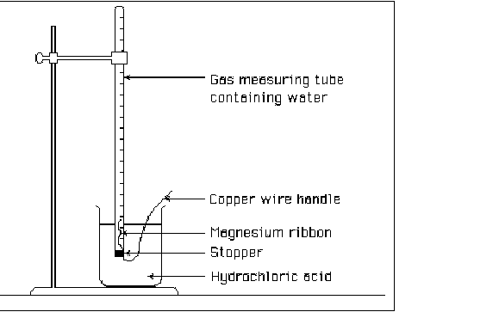
When a Gas is Collected over Water …
Use Dalton’s Law to determine the pressure of the gas!
P_{T} = 619 mmHg (atm Pressure)
P_{H2O} = 21 mmHg
P_{G} = Pressure gas?
P_{T} = P_{H2O} + P_{G}

Slide 18
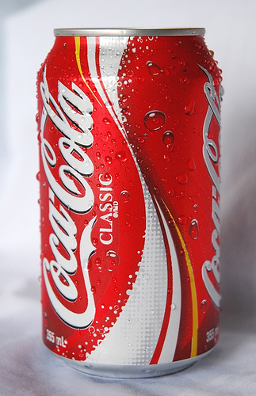
There are 205 mL of gas in an aluminum can at 85°C and 0.832 atm.
Determine the volume of
the gas when the can is
cooled to 3°C and the pressure is 1 atm.
Explain what happens to the gas in the
can (on a molecular level).

Slide 19
Graham’s Law of Effusion
The rate of effusion (diffusion) of a gas is inversely proportional to the square root of its molar mass
rate (gas A) = √molar mass B rate (gas B) √molar mass A
The larger the mass the slower the diffusion
Compare the rate of effusion of Cl₂ to O_{2.}

