Slide 1
GOOD MORNING!
Today we will:
Turn in Unit 4 Vocab
Keep your Layers of the Atmosphere Packet
If you already turned it in, grab it from the basket
Pick up
EDR
Bottle Lab: Energy Transfer in Different Atmospheric Gases
Warm Up
Notes on Greenhouse Gases
Problem Statement Hypothesis
HW: Graph & Calculations of Data from Lab DUE Tues 11/3

Slide 2
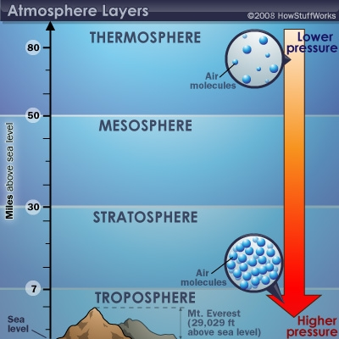
Use your atmosphere graph to answer the following
Which layer of the atmosphere is the coldest? Why?
What important molecule absorbs UV radiation in the stratosphere?
Identify the main type of radiation(EMR) that
travels through the
atmosphere layers and
reaches the surface of the
Earth.

Slide 3
How does EMR affect our atmosphere?
51% of the electromagnetic radiation that gets through atmosphere to Earth is absorbed at the surface
This is converted to infrared (heat) and released back into the atmosphere (troposphere)

Slide 4
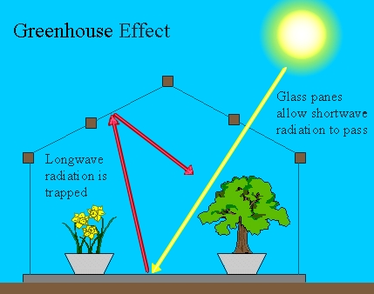
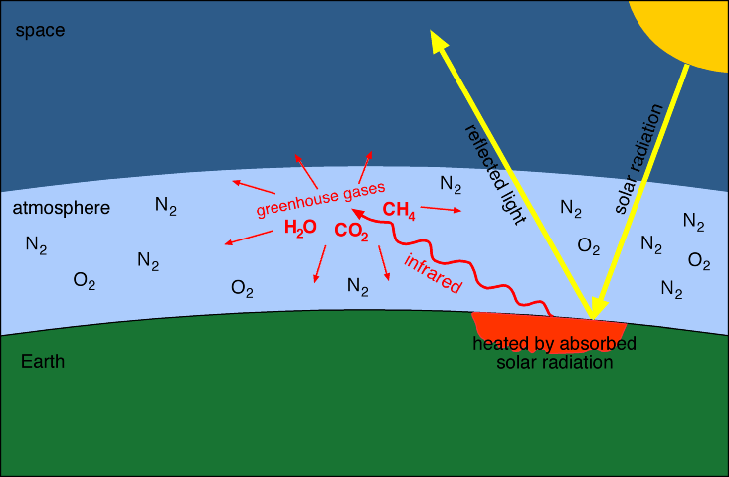
The Greenhouse Effect
The earth’s atmosphere acts like a greenhouse.
Short-wave light passes through the atmosphere
Long-wave light (heat)
is trapped by atmospheric gases
This is what keeps our temperature just right for Earth processes that support living organisms

Slide 5
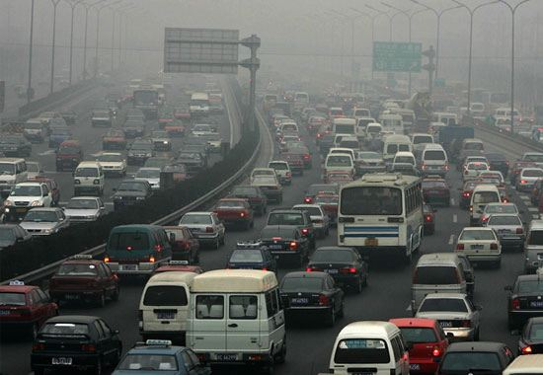
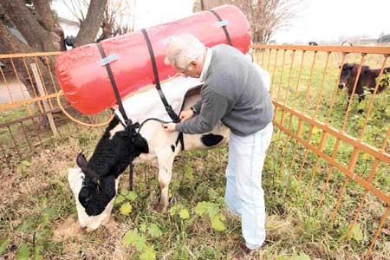
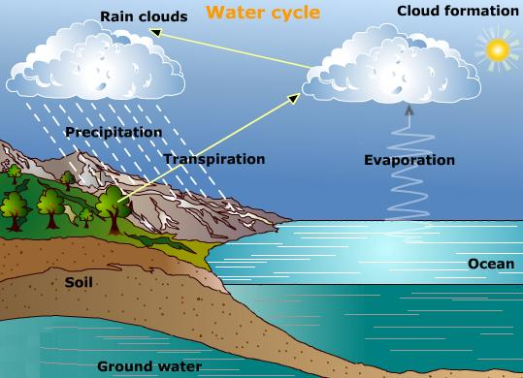
Greenhouse Gases
The most significant greenhouse gases are:
Carbon dioxide – released from plants and animals, volcanoes, and human activities such as burning fossil fuels for transportation, factories, etc
Methane – released from swamplands, raising cattle, using natural gas
Water – the concentration varies but it is mostly released through evaporation. When the temperature increases, so does evaporation of H₂O.
Nitrous oxides – produced in soil,
released by fertilizer use,
vehicle and industry emissions

Slide 6
Sources for citing statements in your hypothesis
UCAR website: http://www.ucar.edu/learn/1_3_1.htm
Discovery Education

Slide 7
GOOD MORNING!
Today we will:
Keep your Energy Transfer in Different Atmospheric Gases Lab Packet
Warm Up
Go over Problem Statement/Hypothesis
Procedure
Collect Data
HW: Complete Graph & Calculations

Slide 8
WARM UP: Take out your lab
What is the Independent Variable & the Dependent Variable?
What greenhouse gases will we be observing?

Slide 9
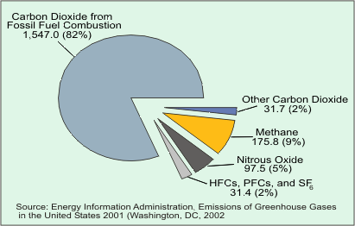
Investigating Greenhouse Gases
Get in your group and do the following:
Identify the gas you will be testing along with air
Read through the procedure and highlight important steps
Make any changes you think are necessary in problem statement and hypothesis
Assign roles for data collection:
Timer
Thermometer Reader
Recorder
2nd Recorder / stabilize the bottle

Slide 10
Lab Group Greenhouse Gas Assignment
#1 – CO₂
#2 – CH₄
#3 – H₂O
#7 – CO₂ & H₂O
#8 – CH₄
#4 – CO₂
#5 – CH₄ & H₂O
#6 –

Slide 11
GOOD MORNING!
Today we will:
Warm Up
Complete Analysis Questions for the Greenhouse Gas Bottle Lab
Turn in Lab
Phet Simulation Greenhouse Effect
Quick Kahoot Review
HW: Complete Phet Simulation Quiz Wednesday on the Atmosphere

Slide 12
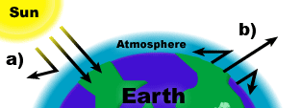
Use the diagram below to explain how the Earth’s atmosphere traps heat
Name 3 of the most common greenhouse gases and explain what they do.

Slide 13
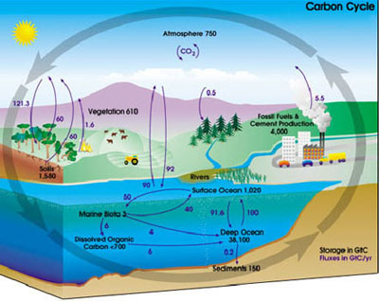
Carbon Cycle
How is carbon released and
absorbed to / from the
atmosphere?
Carbon Sources – processes
or structures that release
carbon
Carbon Sinks – processes or
features that absorb carbon
Parts per million – the amount of one molecule that is in a sample of a million molecules

