Slide 1
GOOD MORNING!
Today we will:
Turn in Freshwater Ecosystem Lab Report
EVERYONE must turn in typed data tables
WARM UP
Finish Native/Exotic Species Reports
Begin Diverse Variation in Populations
Notes
Sunflower seed Activity
Histogram Graph of Data
HW: DUE Mon 3/14 Vocab & Calculations of Sunflower seed Activity

Slide 2
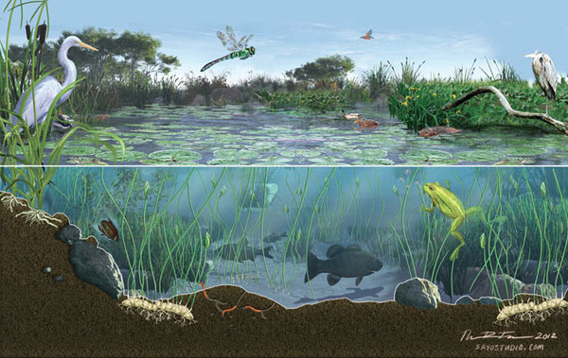
WARM UP: Changes in Ecosystems and Organisms
What do we mean when we use the following terms?
Community
Population
Species
Individual
Look at this freshwater ecosystem and give an example of each of the above.

Slide 3
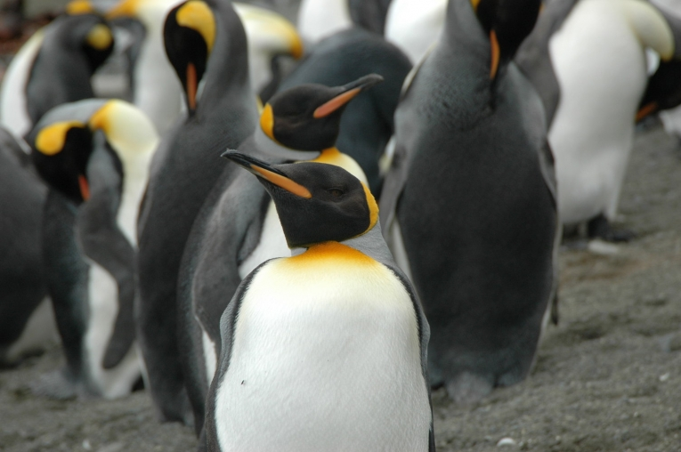
3 types of biodiversity
Biodiversity includes all organisms, species, and populations in an ecosystem.
There are three levels of biodiversity: genetic, species, and ecosystem diversity.
Genetic diversity refers to the different genes contained in all individual organisms. It occurs within a species and between species. Within a species we usually say “VARIATION”.
• Species diversity is all the differences within and between species.
• Ecosystem diversity is all the different habitats, biological communities, and ecological processes.

Slide 4
Which field is more DIVERSE? Explain.
Short grass prairie
Corn field

Slide 5
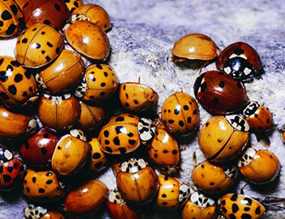
Describe the Variation in the population

Slide 6
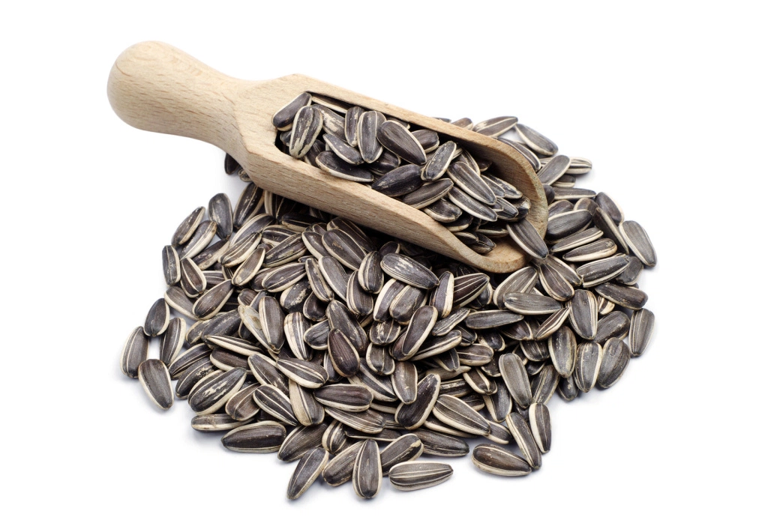
SUNFLOWER SEED ACTIVITY
No Lab Write Up
Find a partner!
Each person needs to measure sunflower seed length
50 seeds per person
Put data in class data table
Everyone must construct a Histogram

Slide 7
Some important terms when describing quantitative data
Mean:
the average of all values in a sample
Mode:
the most frequent or most common value
Median:
the middle value when ordered small to large
Range:
the difference between the largest value and the smallest value

Slide 8
CLASS DATA: Number of Shells with Different Length Write your group’s number of shells below each number.
Length mm | 6 | 7 | 8 | 9 | 10 | 11 | 12 | 13 | 14 | 15 | 16 | 17 | 18 | 19 | 20 | 21 | 22 | 23
# shells With this length per group
Total Shells With length

Slide 9
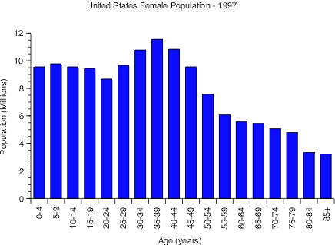
Making a Histogram
A histogram is a graph showing a frequency distribution of measurements
The Y axis shows
the number of times
(frequency) a measurement occurs
The X axis shows values (or value ranges) for the measurement
The data is shown as a bar graph
Include a title that describes what is being graphed

