Slide 1
Compound Microscope and Images
Cells and Freshwater Organisms

Slide 2
The Compound Microscope

Slide 3
GOOD MORNING!
Today we will:
Turn in Biological Drawing Questions #1-3
WARM UP
Organism Sketches
Honors/Extra Credit: Field of View
Organism Specifics
HW:
Kingdoms of Organisms Checklist DUE Wed 1/27

Slide 4
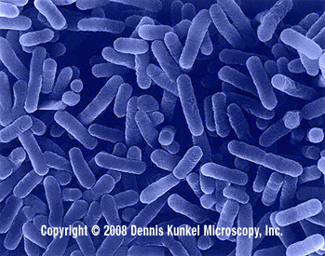
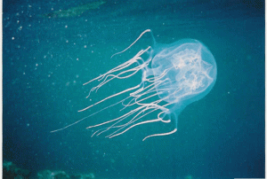
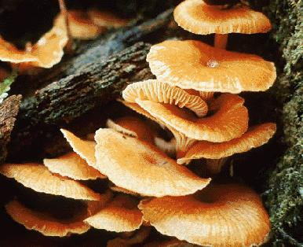
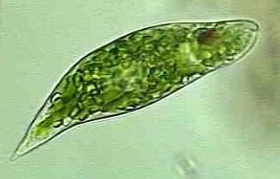
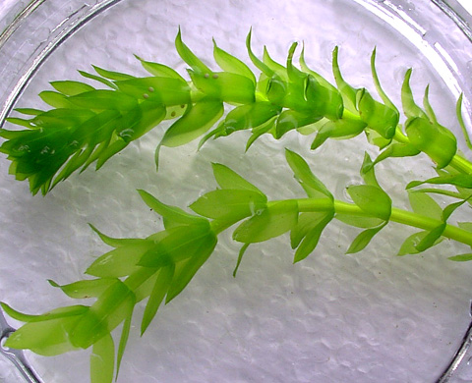
WARM UP
Match each organism with their Kingdom!
Jellyfish
Mushrooms
Euglena
Elodea

Slide 5
BEFORE WE BEGIN SKETCHES…
What does a good sketch look like?

Slide 6
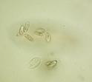
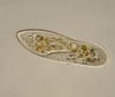
Field of View
How does field of view change when objective goes from low power to high power?
Sketching Paramecium:
This? or This?
Measuring Field of View with Ruler

Slide 7
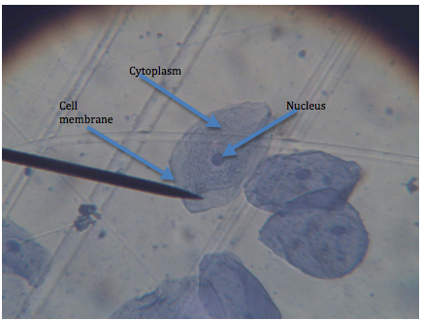
Human Cheek Cells

Slide 8
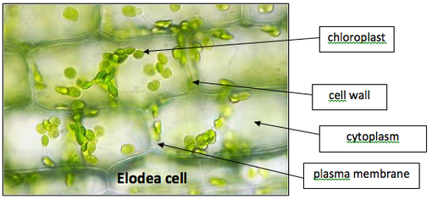
Elodea Plant and Cells

Slide 9
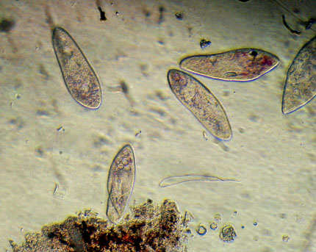
Paramecium

Slide 10
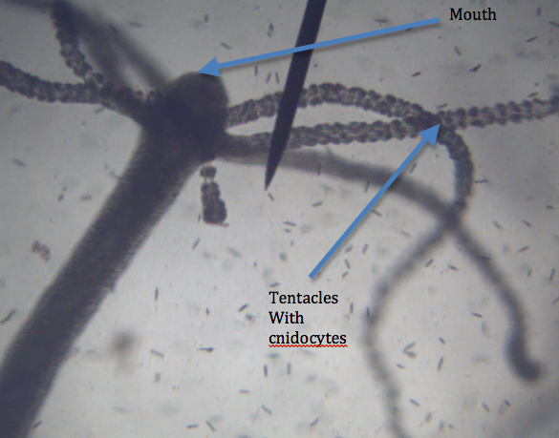
Hydra

Slide 11
Volvox

Slide 12
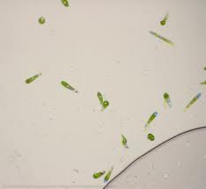
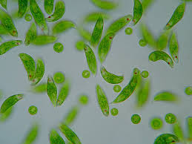
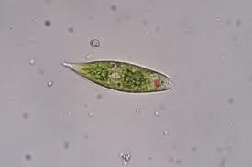
Euglena

Slide 13
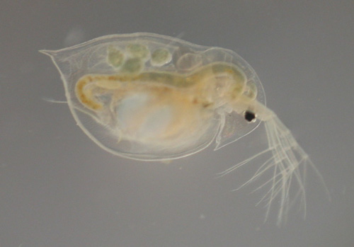
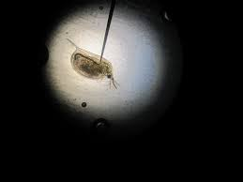
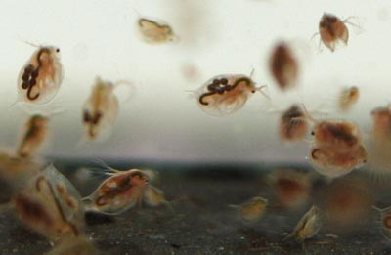
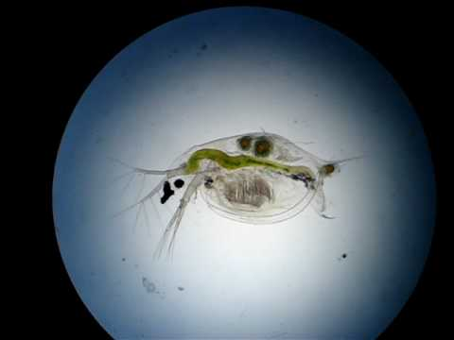
Daphnia

Slide 14
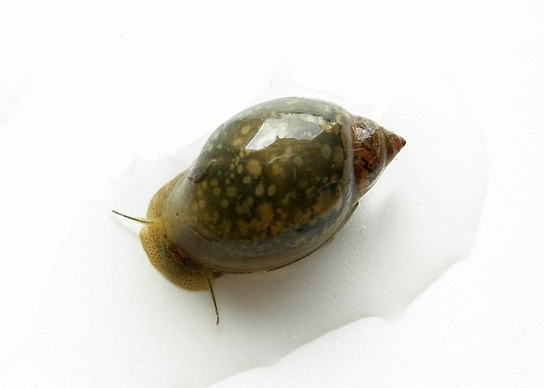
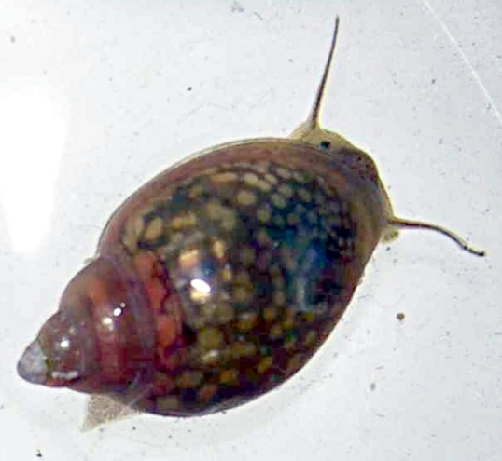
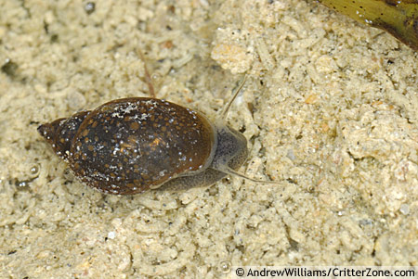
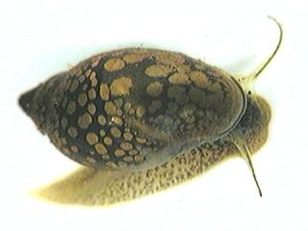
Freshwater Snail

Slide 15
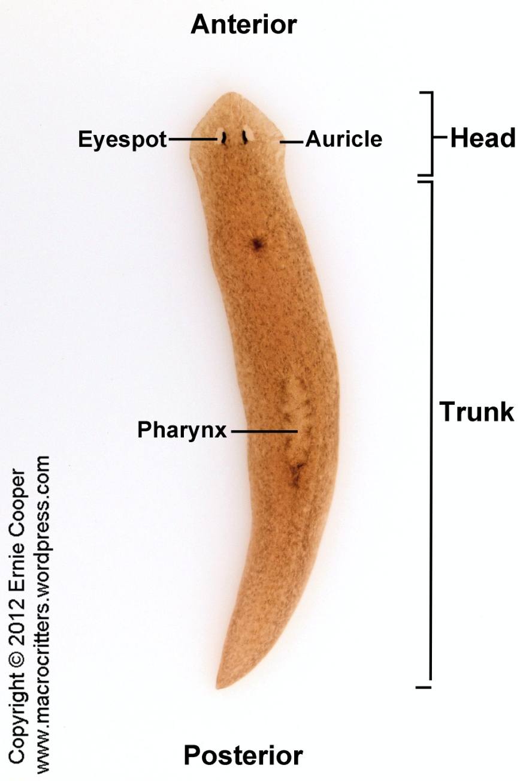
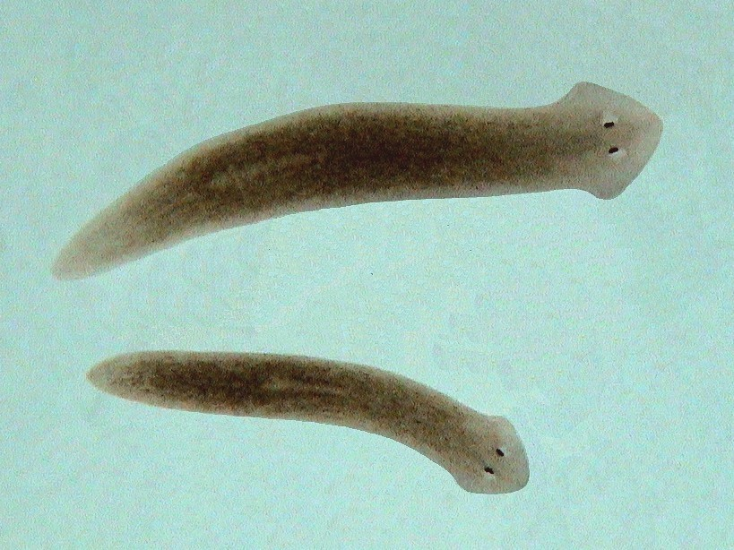
Planaria

Slide 16
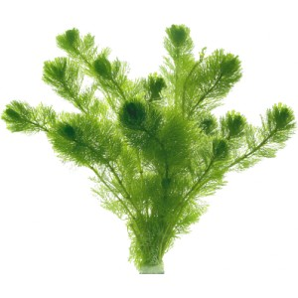
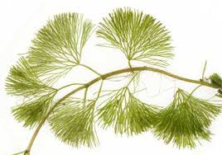
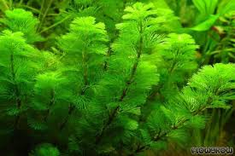
Cabomba

Slide 17
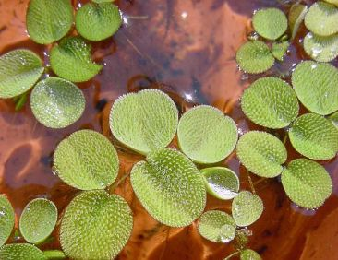
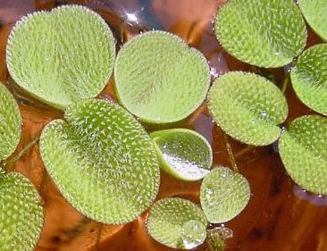
Salvania

Slide 18
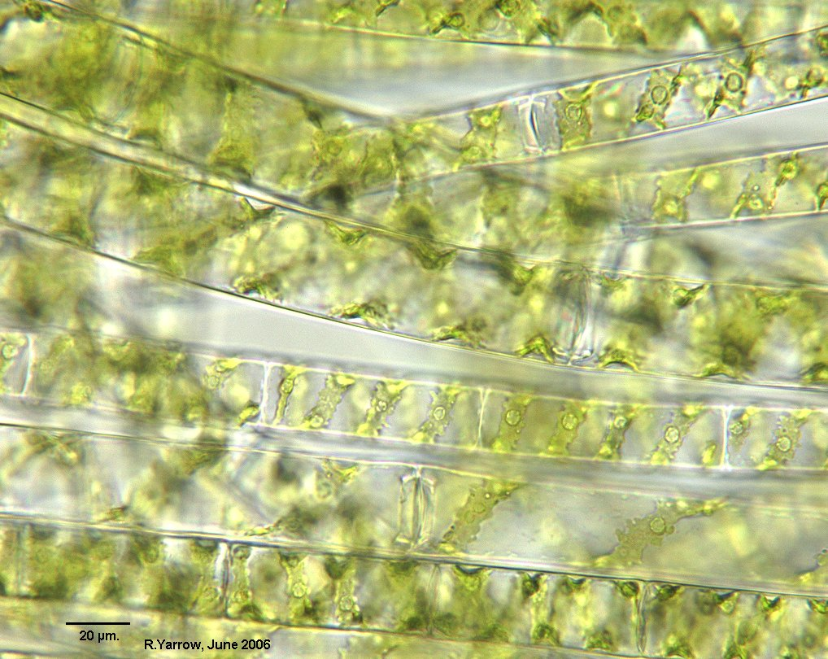
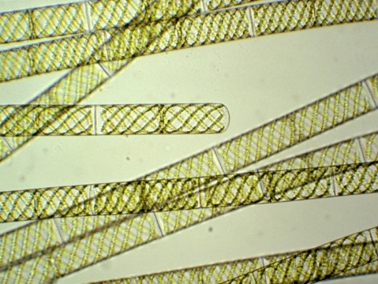
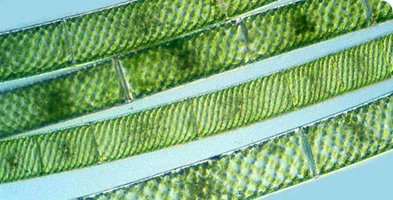
Spirogyra Algae

Slide 19
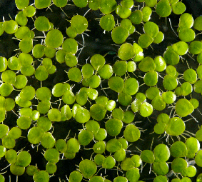
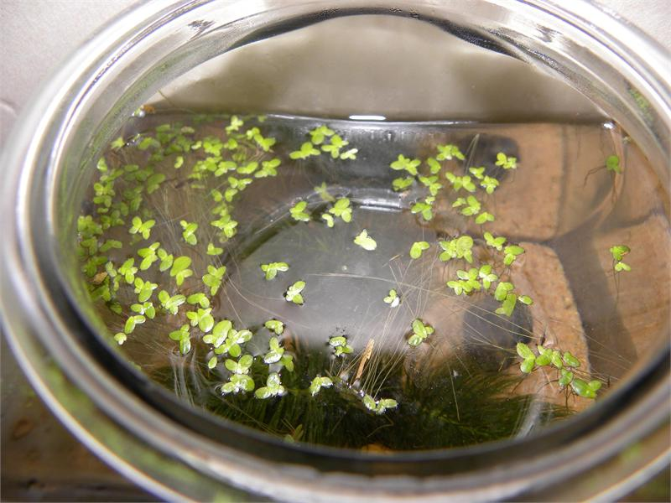
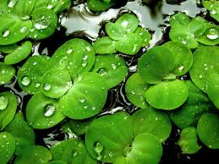
Duckweed

Slide 20
GOOD MORNING!
Today we will:
Turn in Kingdoms of Organisms Checklist
WARM UP
Organism Sketches
Honors/Extra Credit: Field of View
MUST COMPLETE: all organisms TODAY
Kahoot Review
HW:
Work on Test Review Packet

Slide 21
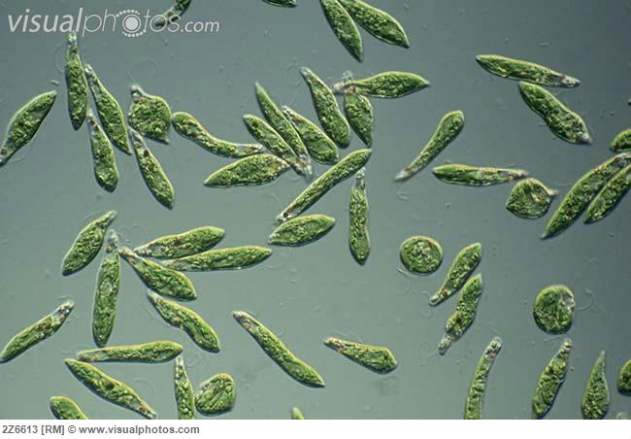
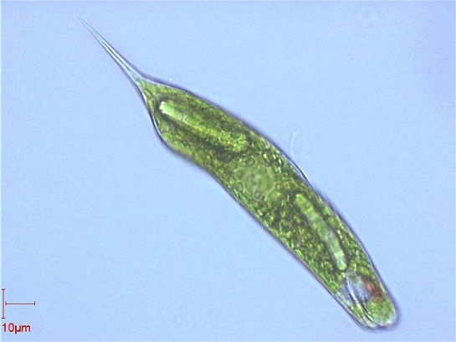
WARM UP: Identify the organism!
Name its kingdom
State how energy is obtained
How does the organism move?

Slide 22
GOOD MORNING!
Today we will:
WARM UP
Organism Sketches
Honors/Extra Credit: Field of View
MUST COMPLETE: all organisms TODAY
8:10 microscopes/lab table CLEAN
Kahoot Review
HW:
Work on Test Review Packet

Slide 23
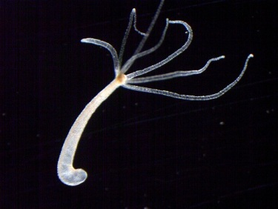
WARM UP: Identify the organism!
Name its kingdom
State how energy is obtained
What type of habitat can this
organism be found in?

