Slide 1
GOOD MORNING!
Today we will:
Turn in CARS Article & Intro to Bonding
1st column of Vocab
Warm Up
Finish Notes on Intro to Bonding
Naming Ions & Ionic Compounds
Notes
Puzzle Activity
HW: DUE Tues 2/2 – Ions & Ionic Compounds Practice Problems and Memorize Common Ions for Quiz

Slide 2
WARM UP
Determine the type of bond you would expect in the following substances:
NaCl
H₂O
SO₂

Slide 3
Types of Substances and their Properties
Ionic Compounds | Covalent Compounds | Metals
High melting pt Usually soluble in water Conducts electricity in water or melt Does not conduct electricity as solid Crystalline | Low melting pt Sometimes soluble in water (polar) Never conducts electricity (except acids) Sometimes crystalline Brittle if solid | Variable melting pt Insoluble in water Conducts electricity Shiny Malleable Ductile

Slide 4
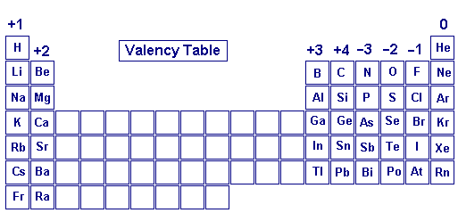
Predicting Charges

Slide 5
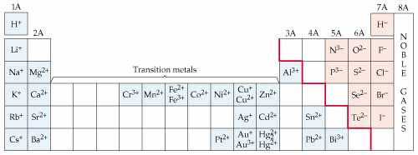
Transition Metals are unique!

Slide 6
Formulas and Names for Cations
Cations (+ ions) Metals:
Group 1, 2, 3: metal name, valence e⁻ = (+) charge
Transition: metal name AND roman numeral = (+)charge
Except silver (Ag⁺) and zinc (Zn²⁺): NO roman numeral
Only Nonmetal cation (polyatomic):
Ammonium = NH₄⁺
Examples:
Sodium = Na⁺
Calcium = Ca²⁺
Iron (III) = Fe³⁺

Slide 7
Formulas and Names for Anions
Anions (- ions) Nonmetals:
Monatomic ion (one element)
Root of element name and ending “ide”
Charge = (-) # of valence e⁻ needed to make 8
Examples: chloride = Cl⁻
oxide = O²⁻
Polyatomic ion (2 or more elements)
Root of first element and ending “ate” or (“ite”)
Charge must be memorized
Examples: sulfate = SO₄²⁻
nitrate = NO₃⁻

Slide 8
Ionic Compounds
Cation is always first, anion is always 2nd
The number of e⁻s lost = number of e⁻s gained
The final compound is neutral
Examples:
calcium oxide barium fluoride iron (III)sulfide
Ca²⁺ O²⁻ Ba²⁺ F⁻ Fe³⁺ S⁻²
CaO BaF₂ Fe₂S₃

Slide 9
Ionic Compounds
Name / Write the metal (cation) 1st and the
Nonmetal (anion) 2nd
Element symbols subscripts
CuI₂ K₃PO₄
There is 1 Cu There are 3 K and
And 2 I 1 phosphate (1 P and 4 O)

Slide 10
Writing Formulas
Cation symbol is first, anion symbol is 2nd
If charges are balanced, cation / anion ratio is 1/1
If charges are unbalanced, add cations and/or anions so that total (-) charge and (+) charge are equal (CROSS CHARGES to make subscripts)
If a polyatomic ion gets a subscript use ( )
Examples:
magnesium oxide sodium phosphide iron (III) nitrate
Mg²⁺ O²⁻ Na⁺ P⁻³ Fe³⁺ NO₃⁻
MgO Na₃P Fe(NO₃)₃

Slide 11
Name these Ions …
Name Formula
calcium _______
____________ SO₄²⁻
copper (II) _______
____________ K⁺
nitride _______
____________ CO₃²⁻

Slide 12
*Identify the compounds below as ionic or covalent *Describe the structure of each *Compare them in terms of likely Melting Point, Solubility in Water, and Conductivity in a solution. K₂S P₂O₃ *Complete the table below
Name | Ions | Formula
Lithium oxide
Copper (II) hydroxide
 |  | MgSO4
 |  | K₃N
 | Fe ³⁺ NO₃⁻
Ammonium carbonate
 | Ba²⁺ P⁻³

Slide 13
Show what you know about bonding and compounds!
For each of the following compounds:
Identify type of bond and explain how bonds are formed including electronegativity and IE
Describe properties such as melting point, solubility in water, conductivity
Name each compound
FeCl₃ S₂O₃

