Slide 1
GOOD MORNING!
Today we will:
Pick up
Unit 4 Learning Goals
Warm Up
Label/Color Periodic Table
Answer Questions
HW: Unit 4 Vocab & Periodic Table Labeling

Slide 2
Make a Goal (or 2) – We’re on the Downhill Side!
Think about what has gone well – or not – and
make a goal (or 2) for the last half of semester 1!
Consider:
Unit 3 Test
Getting all work turned in
Best effort on work turned in
Engagement in class
Binder organization and glossary
Time organization

Slide 3
Label and color the following groups on your periodic table.
Number each group 1-8 representing valence electrons
Number each period (horizontal row starting at H) 1-7
Label and color code the following groups:
Alkali metals
Alkaline earth metals
Transition metals
Inner transition metals
Metalloids
Halogens
Noble gases
Outline metals and nonmetals (both lines will go through metalloids)
Label s, p, d, f blocks and energy levels: 1, 2, 3, …

Slide 4
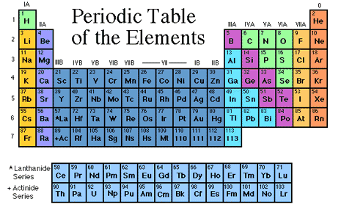
Groups
Alkali metals
Alkaline earth metals
halogens
Noble gases
metalloids
Transition metals
Periods
Not colored
Inner transition metals

Slide 5
GOOD MORNING!
Today we will:
Turn in
Periodic Table/Labeling
Unit 4 Vocab
Warm Up
Notes: valence e⁻’s, periodic table, ionization energy & atomic radius
HW: pg 1-4 Electron Arrangement & Periodic Trends Activity

Slide 6
WARM UP
Look at Period 4 on the Periodic Table
Name 1 of each:
Alkali Metal
Alkali Earth Metal
Transition Metal in Group VB
Classify the Family
IVA
Br
Kr

Slide 7
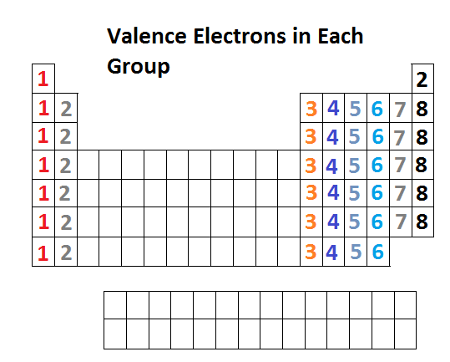
Valence Electrons
Valence electrons: Electrons in outermost (highest) energy level
O: 1s² 2s² 2p⁴
Fe: [Ar] 4s² 3d⁶
Pb:
Determine the valence electrons for the element given and write the number (BIG) on a stickie

Slide 8
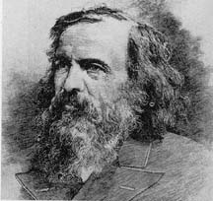
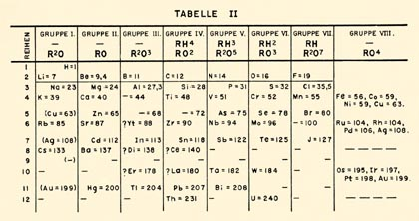
Dmitri Mendeleev 1869
Dmitri Mendeleev organized the
first periodic table of the elements
by “relative mass”
He realized that by
making the rows a
certain length the
elements were also
organized by
properties

Slide 9
Periodic Table: Periods, Groups, Families
Metals: Left side of table to “zig zag”
Nonmetals: Right side of table to “zig zag” + hydrogen
Periods: Rows across →, numbered 1, 2, 3, … down left side (number = outer energy level)
Groups: Columns down ↓, numbered 1 – 8 across top
(number = valence e⁻)
Families: Names -
Alkali Metals
Alkaline Earth Metals
Transition Metals
Inner Transition Metals
Metalloids
Halogens
Noble Gases

Slide 10
Take out Labeled Periodic Table
Name the alkaline earth metal with the largest mass
Identify the 2nd element in period 3
Name 3 metalloids
Identify the noble gas with the fewest energy levels
Determine the number of valence electrons for an atom of sulfur

Slide 11
Groups
Alkali metals
Alkaline earth metals
halogens
Noble gases
metalloids
Transition metals
Periods
Not colored
Inner transition metals

Slide 12
Use Your Labeled Periodic Table to:
State the maximum number of valence electrons an atom can have?
2. Identify the family on the periodic table in which each member has a full valence energy level.
Identify the alkaline earth metal with valence electrons in the 3rd energy level.
Identify a family on the periodic table with 7 valence electrons.
Write an abbreviated electron configuration for the 3rd element in this family (see # 4).

Slide 13
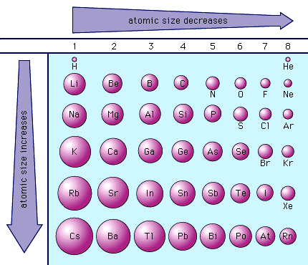
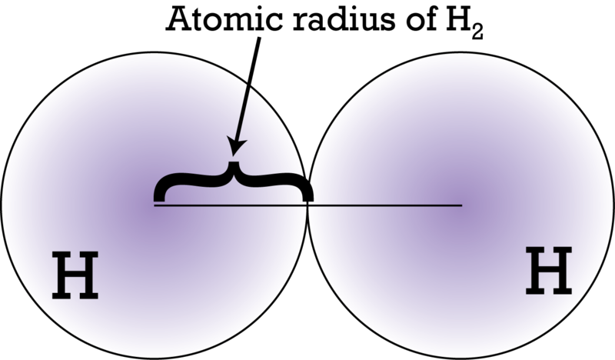
Periodic Trends: Atomic Radius
Atomic Radius (size of atom) – the distance from the nucleus to the valence electrons
Generally increases
from top to bottom and
decreases from left to right
WHY?!

Slide 14
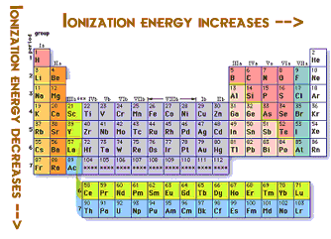
Periodic Trends: Ionization Energy
Ionization Energy – the energy required to remove the outermost electron (J or kJ)
First ionization energy tends to decrease from top to bottom and increase from left to right
But… WHY?!

Slide 15
GOOD MORNING!
Today we will:
Keep your e⁻ Arrangement & Periodic Trends Activity
Warm Up
Share your graphs with your partner
Notes: Electronegativity
Periodic Trends Card Game
HW: Complete Electron Arrangement & Periodic Trends Activity DUE Tues 11/3

Slide 16
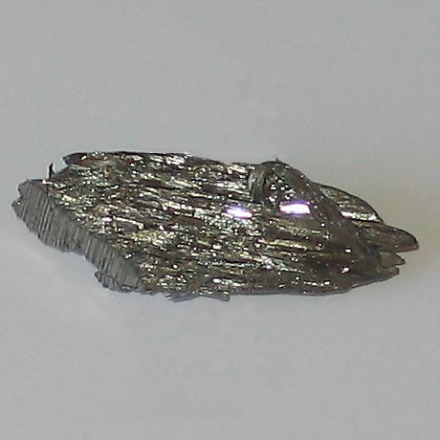
What do you know about barium?
Name the family on the periodic table
Write an abbreviated electron configuration
Determine the number of valence electrons
Determine the nuclear charge
How many energy levels are there in an atom of barium?
Is the radius of a barium atom larger or smaller than the radius of a calcium atom?
Is the ionization energy of barium atom larger or smaller than a cesium atom?

Slide 17
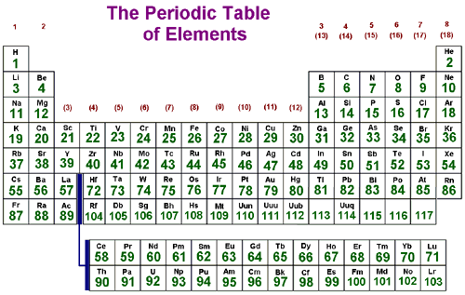
Trends on the Periodic Table

Slide 18
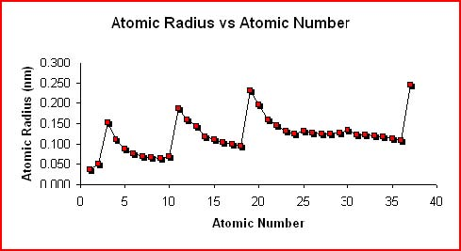
Graph of Atomic Radius

Slide 19
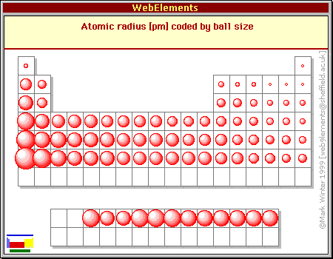
Atomic Radius

Slide 20
Explain the Trend in Atomic Radius
Energy levels (increase ↓)
Shielding (increase ↓)
Nuclear charge (increase →)

Slide 21
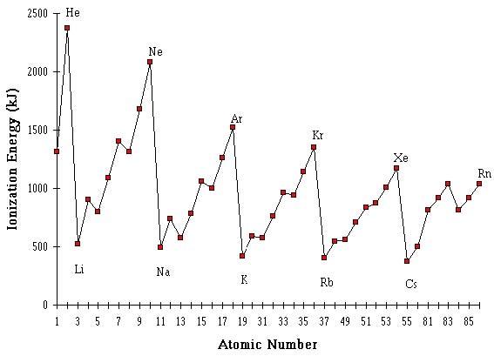
Ionization Energy

Slide 22
Explain the Trend in Ionization Energy
Energy levels (increase ↓)
Shielding (increase ↓)
Nuclear charge (increase →)

Slide 23
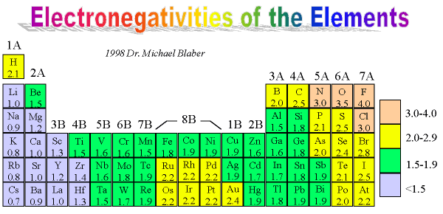
Electronegativity
The attraction an atom has for electrons
Relative scale of 0.3 – 4.0
Directly proportional to ionization energy

Slide 24
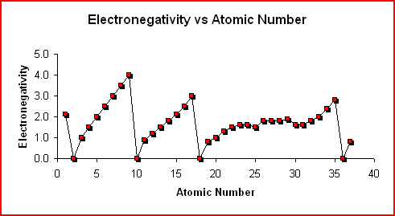
Electronegativity

Slide 25
GOOD MORNING!
Today we will:
Turn in
Periodic Trend Packet & Understanding Periodic Table WKST
Pick up
Unit 4 Test Review
Warm Up
Notes on Ions
Work on Test Review Packet
HW: Unit 4 Test Review Packet

Slide 26
What do you know about phosphorous?
Describe the atomic structure (nucleus / e⁻ s)
Write an abbreviated electron configuration
State the number of valence electrons
Identify at least 3 properties of phosphorous
Compare P to N and S in at least 3 ways

Slide 27
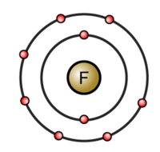
Are you a cation or an anion?
Predict which elements on the periodic table are most likely to lose electrons / gain electrons
Metals are LOSERS → lose valence e⁻ and form cations
Nonmetals are GAINERS → gain enough valence e⁻ to have 8 and form anions
Take it you PIG!
Hey! Gimme that electron!

Slide 28
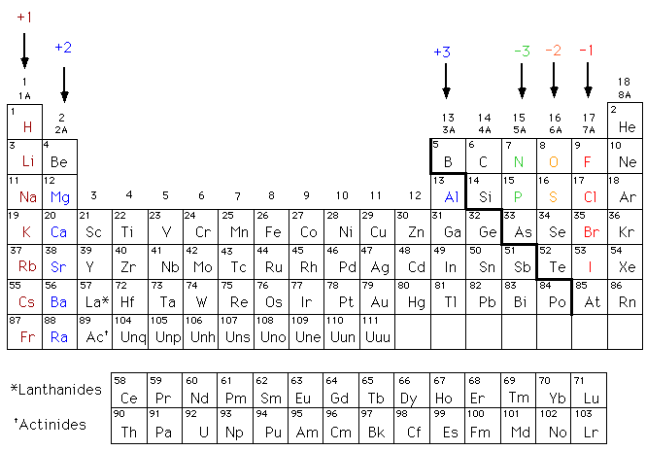

Slide 29
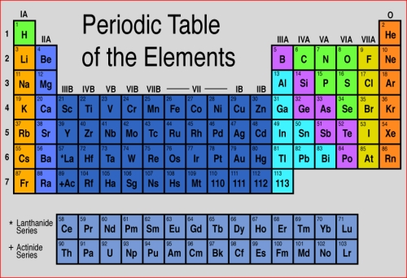
Atomic Radius and Ionization Energy
Atomic Radius | Ionization Energy (I.E.)
Describe the trend in atomic radius as you go across a period Describe the trend in atomic radius as you go down a group Explain why each trend above occurs Compare I, Xe, and Cs in terms of atomic radius What type of ion will I form? Explain why. | Describe the trend in I.E. as you go across a period Describe the trend in I.E. as you go down a group Explain why each trend above occurs Compare I, Xe, and Cs in terms of I.E.

Slide 30
What’s My Charge?
I’m an atom of arsenic:
Am I more likely to form a cation or an anion?
What is my most likely charge?
Explain the ionic charge you predicted (include IE, EN, valence e⁻ s, and nuclear charge).
As

Slide 31
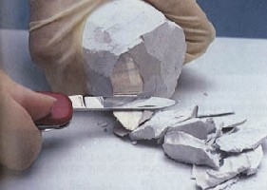
Properties of Metals and Nonmetals
Metals Nonmetals
Nuclear Charge:
Radius:
Ionization Energy:
Electronegativity:
Ionic charge:
Luster:
Texture:
Conductivity:

Slide 32
Ionic Compounds
Ionic compounds form when a cation(s) is combined with an anion(s) due to a transfer of valence electrons
The electrons are transferred from an atom with a low IE and a low EN to an atom with a high IE and a high EN
Electrons are transferred from metals to nonmetals
The electron transfer must be balanced
Combine Ca and S. Try Ca and Br.

Slide 33
Get with a partner and compare the elements below in terms of EN and Atomic Radius and write a formula for a Compound
Electronegativity: Se and Br
Explain why.
Atomic Radius: Kr, Sr²⁺ , Se²⁻
Explain why.
Write the symbols for the ions of Ba and Se.
Explain the charge you gave the ions.
Write the formula for the compound formed from Ba and Br.

Slide 34
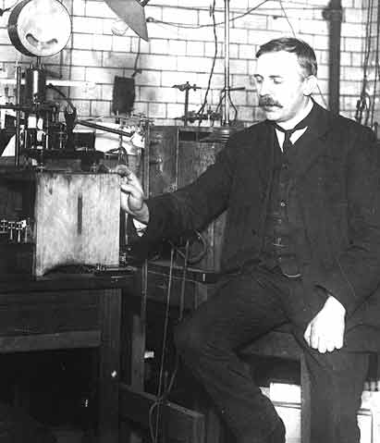
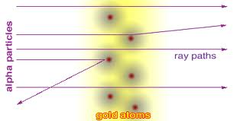
What!! a Poem about Atoms??
Who is Robert Frost writing about in his poem and what is he saying?

